Slide 1
Apply an AWS Credit

Slide 2
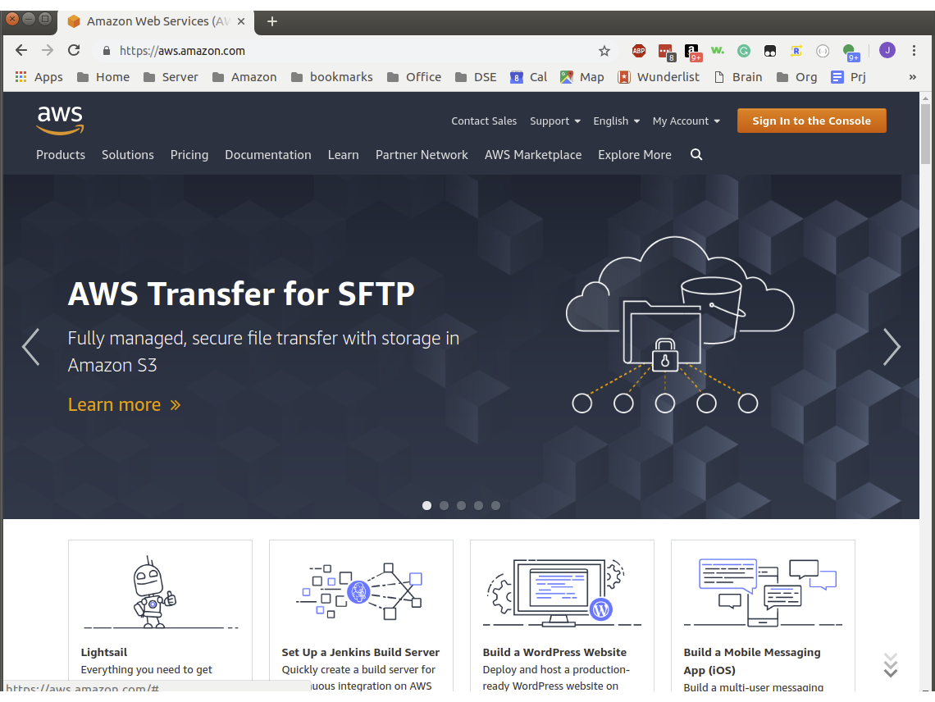

Sign In to the Root Account
Navigate to https://aws.amazon.com and click on Sign In to the Console.
You should have already created an AWS account

Slide 3
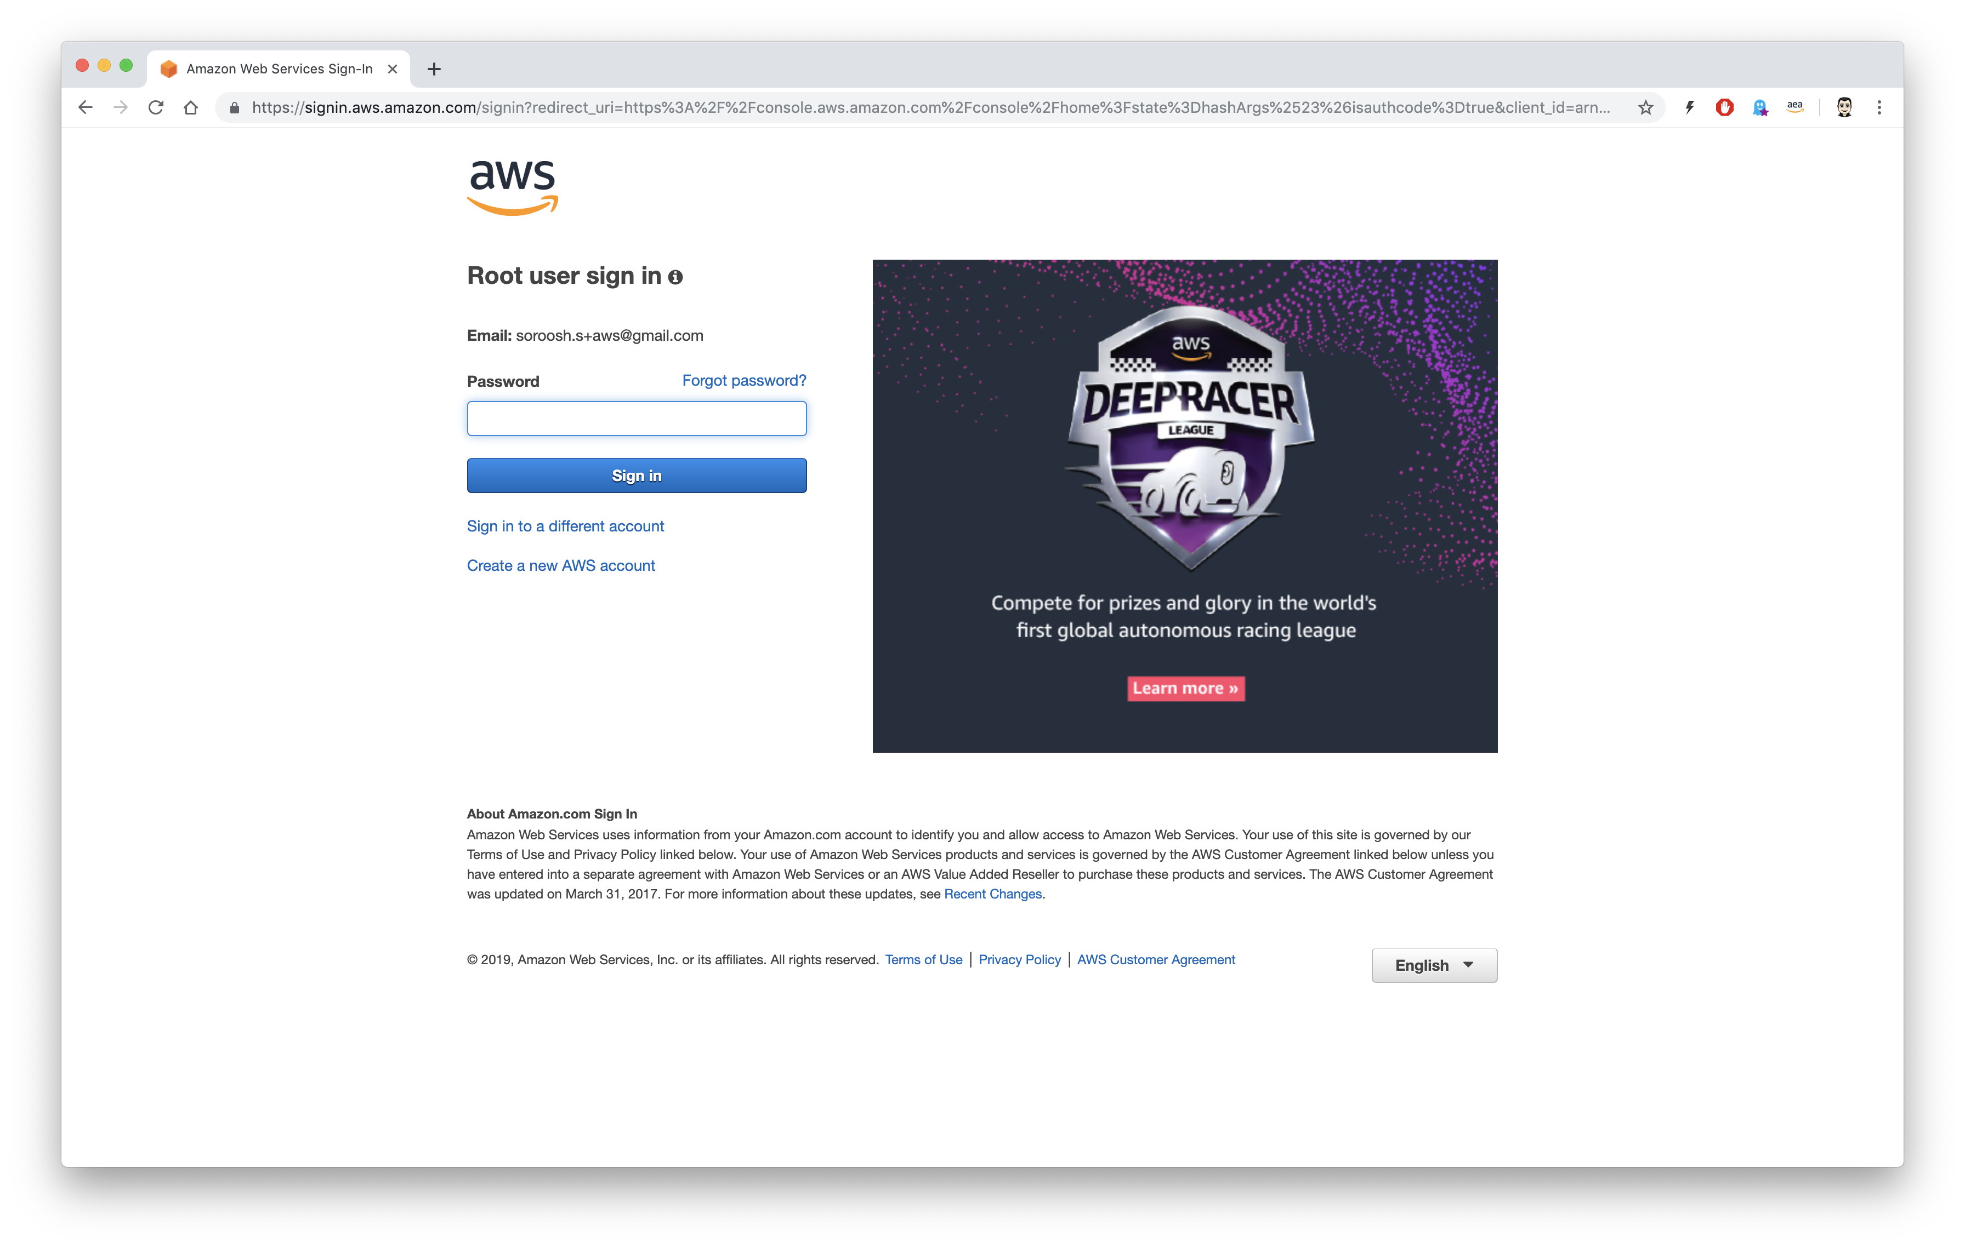

Root use sign in
Enter your password

Slide 4
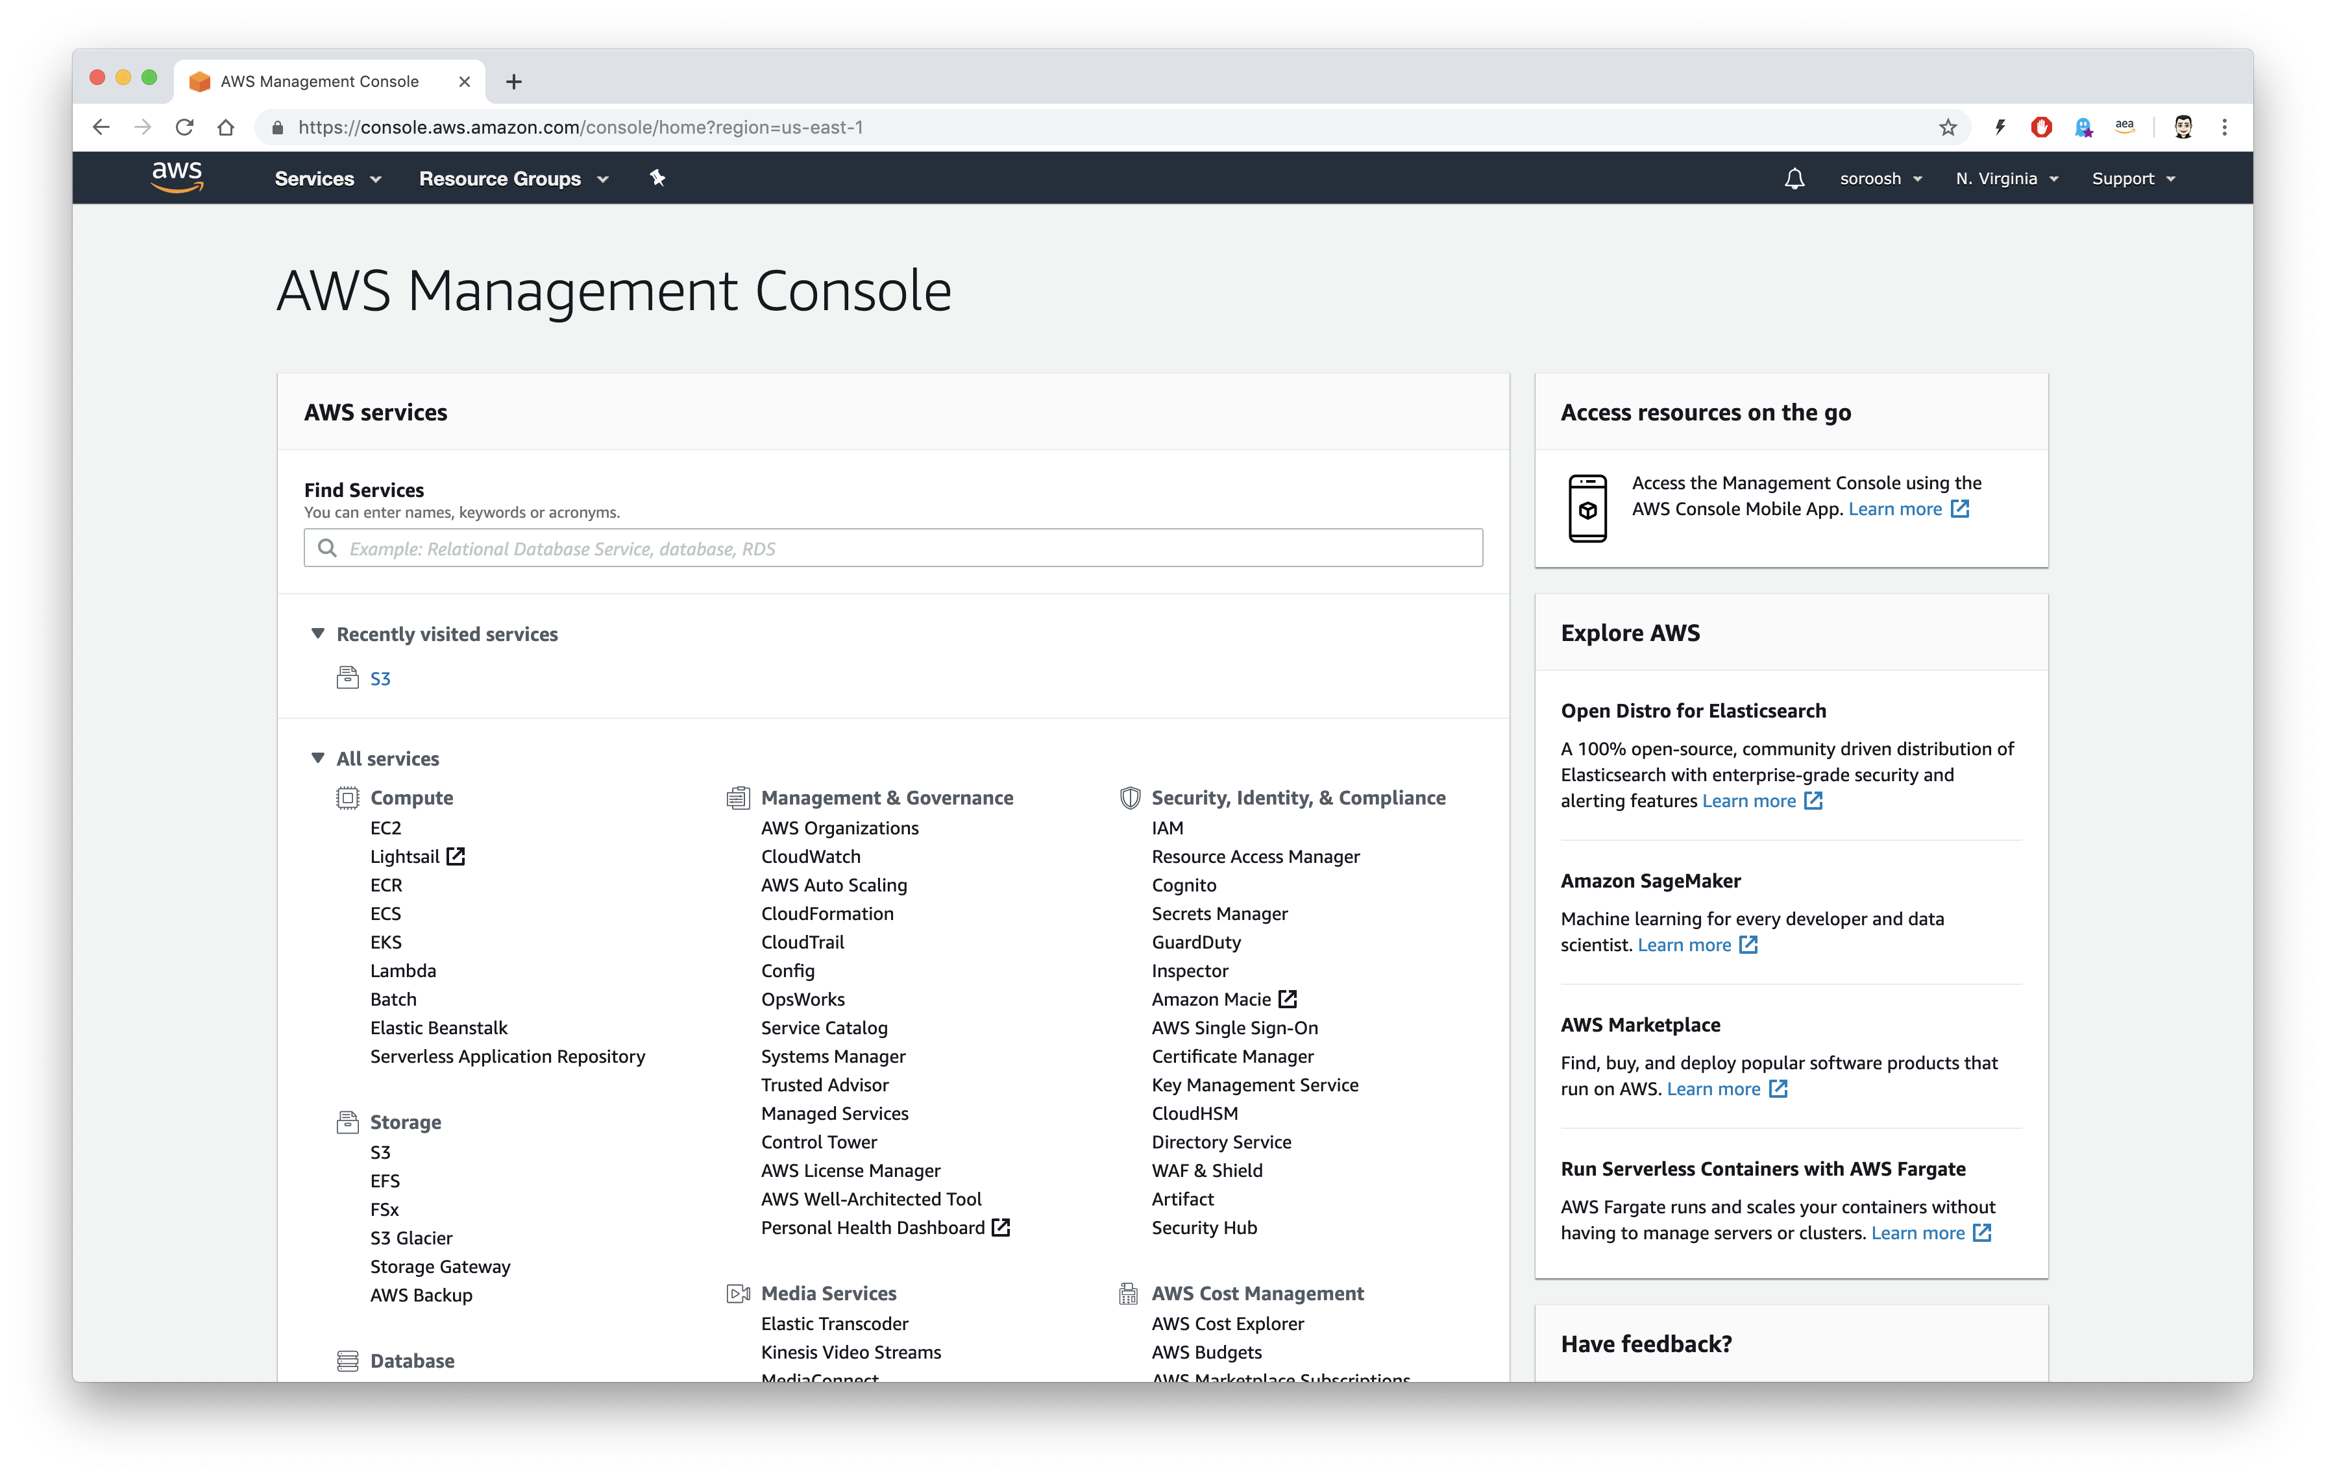
AWS Management Console
Now you are at AWS Management Console

Slide 5
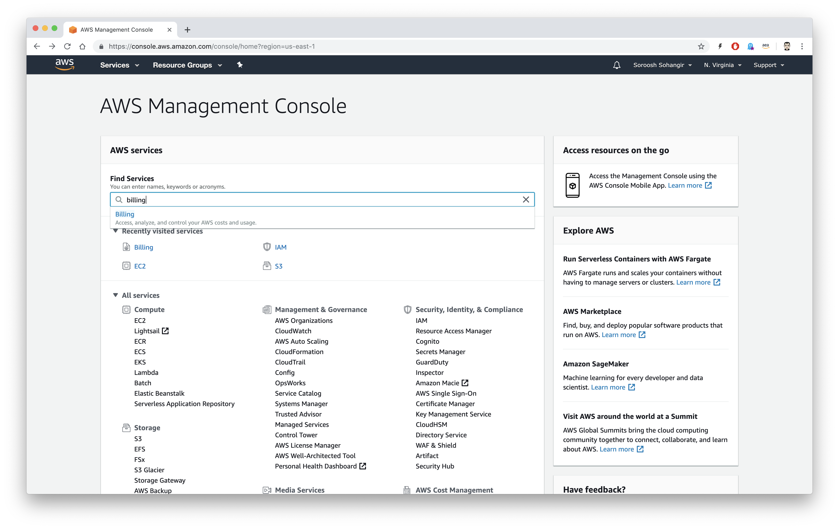

AWS Management Console
Login to your ROOT USER, AWS Management Console and search Billing in find Services.

Slide 6
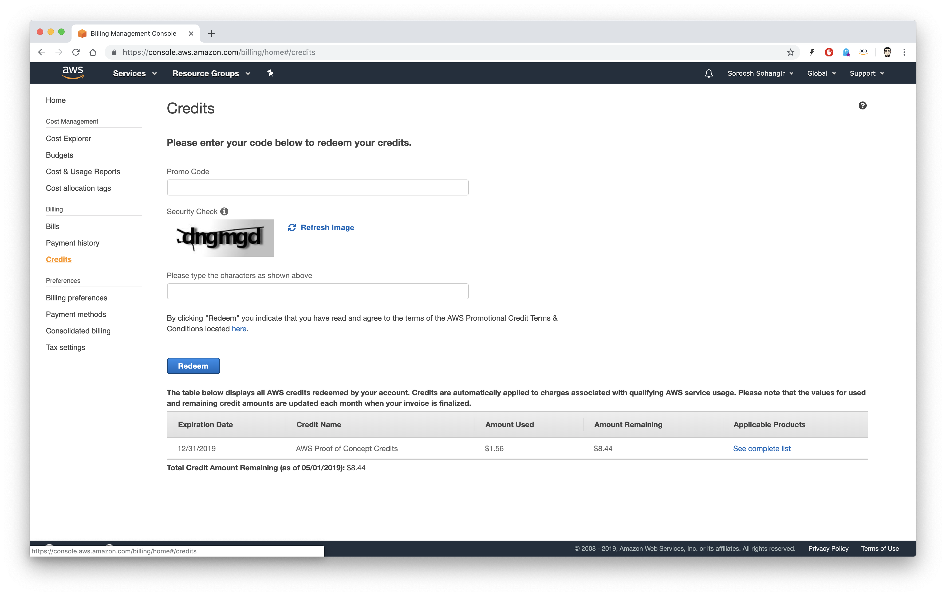
Credits
Click on Credits

Slide 7
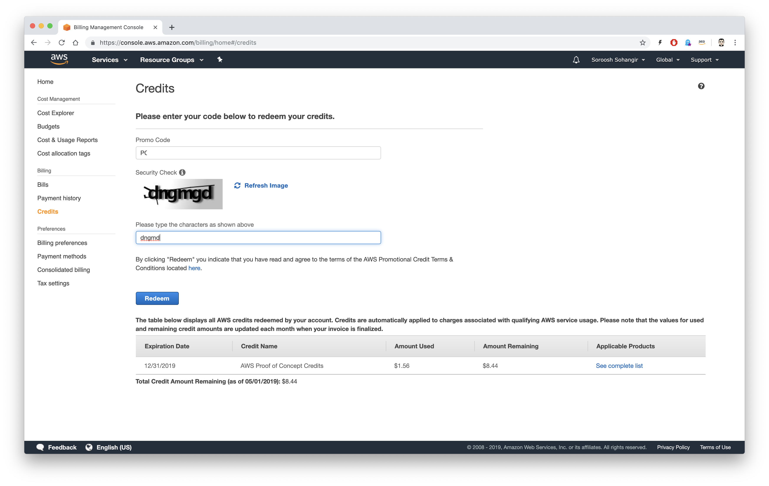


Redeem your Promo
Enter your Promo, Security code, and click on Redeem.

Slide 8
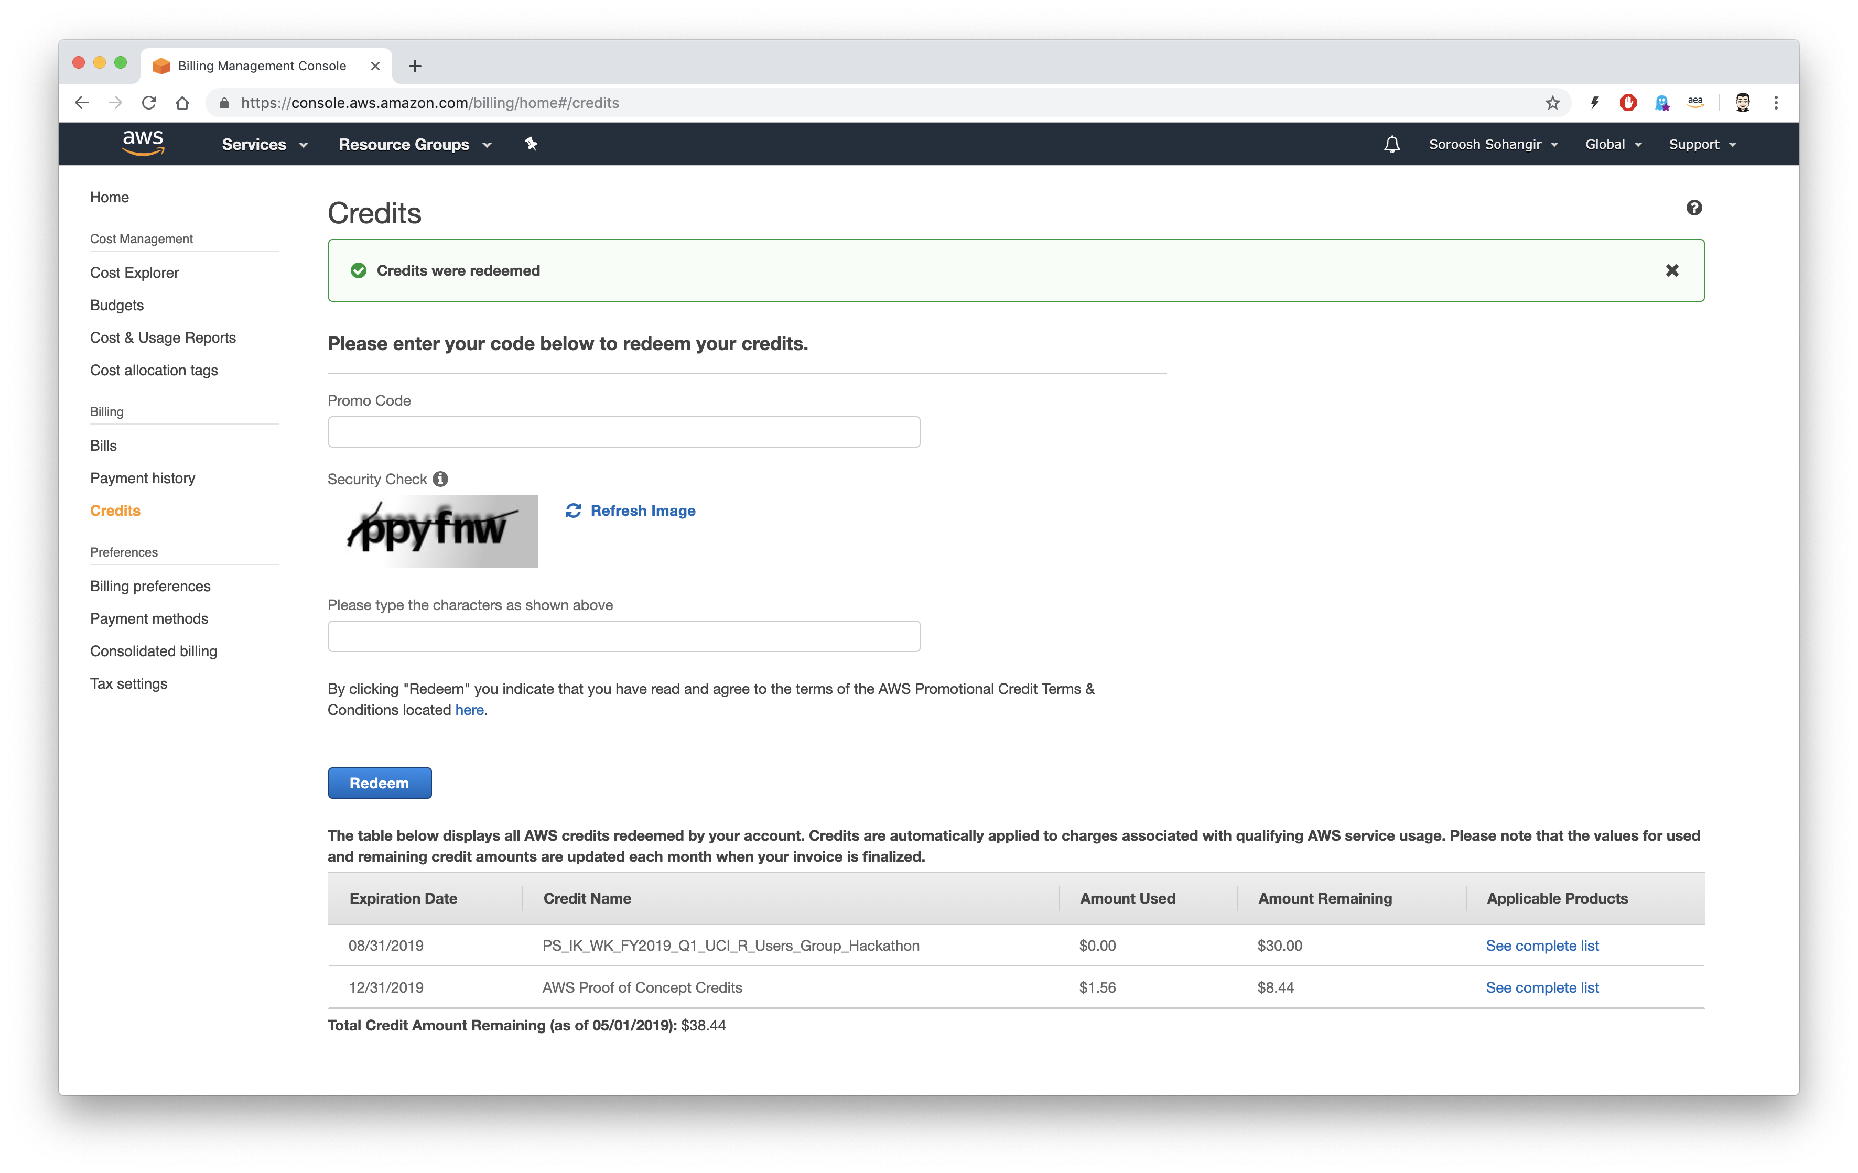
Confirmation
The credits were redeemed.

